Slide 2
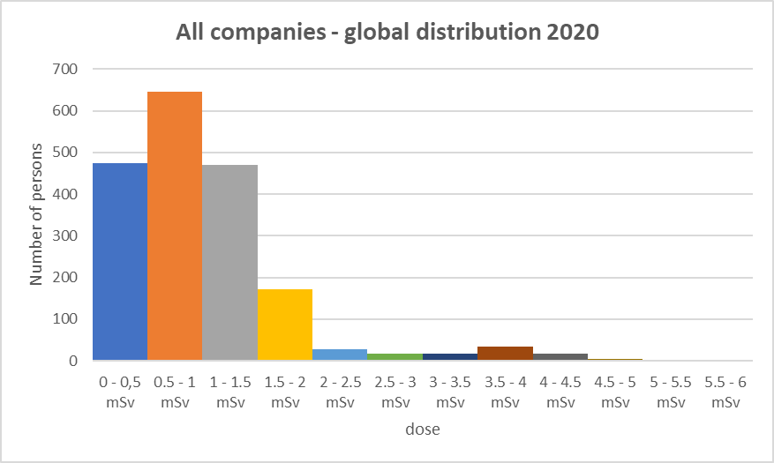
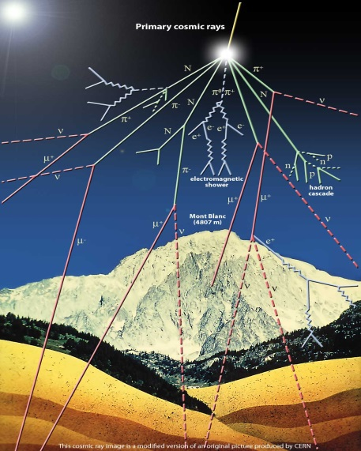
Aircrew exposure to cosmic radiation: an overview

Slide 3
Contents
What is cosmic radiation?
Exposure to cosmic radiation
Cosmic radiation and radiation protection
Current regulations

Slide 4
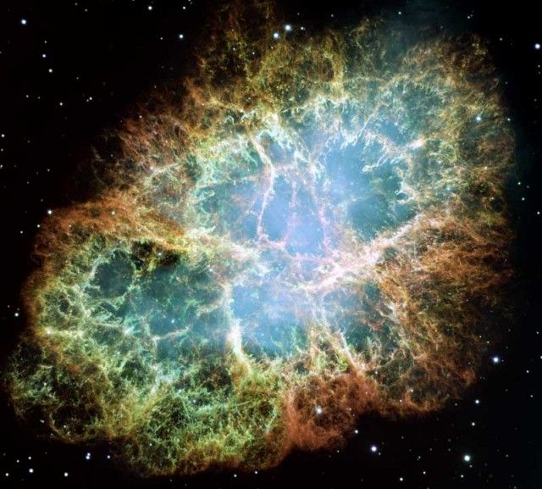
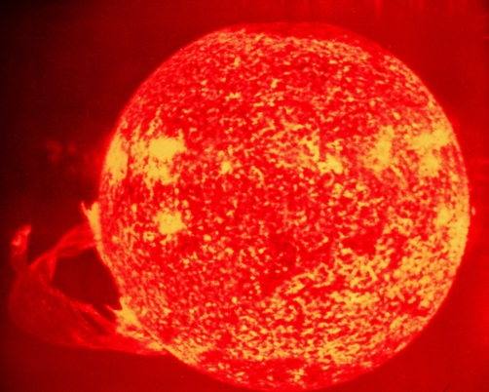
What is cosmic radiation?
Primary cosmic radiation: high energetic particles from space (mainly hydrogen and helium nuclei)
Galactic component (main component):
e.g. supernova explosions,…
Solary component
(11-years cycle, may be significant in case of solar disturbance event / solar flare – e.g. 1956)
Maximum dose from cosmic radiation at minimum solar cycle

Slide 5
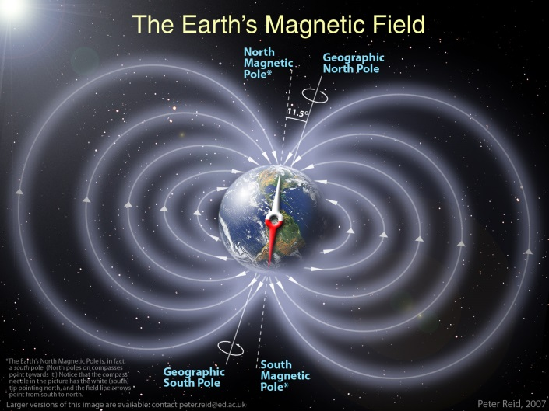
What is cosmic radiation?
Secondary cosmic radiation - interaction of
primary cosmic radiation with earth’s atmosphere
=> secondary particles
2 main factors affecting the flux of
cosmic radiation:
Altitude (absorption by the atmosphere)
Latitude (protection due to
earth’s magnetic field decreases
with latitude – highest dose near
the poles)

Slide 6
Exposure to cosmic radiation
At typical cruising altitude:
dose-rate 10 to 100 X than at sea level
Aircrew
Average dose > 1mSv
Max. dose < 10 mSv
Distribution of dose aircrew
≠ « nuclear » workers

Slide 7
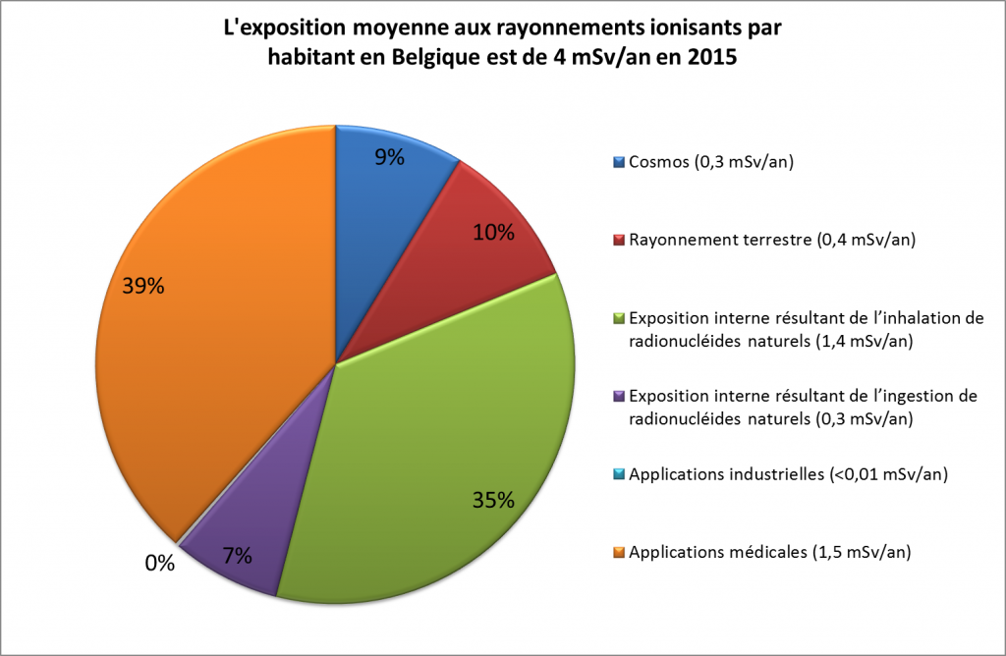
Exposure to cosmic radiation
At sea level: average annual exposure to cosmic radiation in Belgium = 0,3 mSv
(total average dose from all natural sources = 2,4 mSv)
Dose distribution for Belgian aircrew (2020)
average = 0,98 mSv
Max = 4,98 mSv

Slide 8
Cosmic radiation and radiation protection
International Commission for Radiation Protection (ICRP) – Publication 132
recommendations for radiological protection from cosmic radiation in aviation
Epidemiological studies :
no clear relationship between dose from cosmic radiation and increased cancer-risk
Dose-assessment through calculations codes

Slide 9
Current regulations
European directive 2013/59/euratom (Basic Safety Standards regarding radiation protection) confirmed the prescriptions of the previous european directive 96/29/euratom
Implemented through Royal Decree 20/07/2001
Art. 9 :
For aircrew with dose possibly > 1mSv/y:
assess individual doses
transfer individual doses into national dose registry
take into account dose assessments in the working schedules
inform the concerned workers (+ company occupational physician)
limitation of doses during pregnancy (As Low As Reasonably Achievable – in any case < 1 mSv/y)
Obligation to appoint a “Radiation Protection Officer” within the company = central contact person for matters regarding radiation protection approval by FANC necessary : at least basic knowledge on cosmic radiation (through e.g. e-learning courses)
NB: no specific medical follow-up if dose < 6 mSv/y (see also ICRP recommendations)
Aircrew exposure to cosmic radiation is considered as a planned exposure situation

Slide 10
Current regulations
Calculation codes need to fulfill quality criteria defined by FANC (see Règlement technique de l’AFCN du 8 novembre 2021 fixant les critères de qualité relatifs aux méthodes d'évaluation des doses provenant de l'exposition au rayonnement cosmique du personnel navigant):
      system of quality management type ISO 9001 of equivalent;
      code documented + validation procedure;
      participation to intercomparison exercises.
Survey by FANC in 2017
all codes currently used in Belgium already fulfill these criteria
Indicative list of codes available on FANC website:
Rayonnement cosmique | AFCN - Agence fédérale de Contrôle nucléaire

Slide 11
Current regulations
FANC receives doses from 6 airlines registered in Belgium
2020:
- 1879 individual doses
- 758 doses > 1 mSv
Since 2007, only one occurence of dose > 6 mSv
Doses Belgian aircrew comparable to other EU countries

